Slide 1
OTP Verification and Generator
Project by Group-4:
Team Members:
*Hitesh Harshvardhan Thakur (1669)
*Inder Goswami(1677)
*Husandeep Sharma(1675)
Sumbitted to: Miss Soni Singh

Slide 2
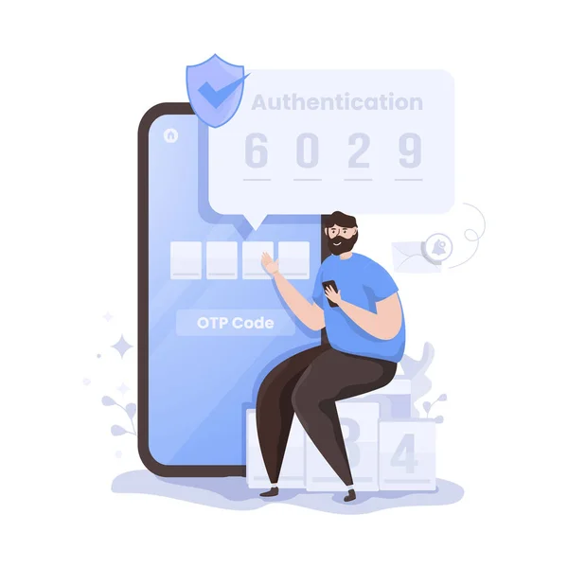
What is OTP?
A one-time password (OTP) is an automatically generated numeric or alphanumeric string of characters that authenticates a user for a single transaction or login session.
An OTP is more secure than a static password, especially a user-created password, which can be weak and/or reused across multiple accounts.
OTPs may replace authentication login information or may be used in addition to it to add another layer of security.

Slide 3
Languages Used
HTML:The HyperText Markup Language or HTML is the standard markup language for documents designed to be displayed in a web browser. It can be assisted by technologies such as Cascading Style Sheets and scripting languages such as JavaScript
CSS:Cascading Style Sheets is a style sheet language used for describing the presentation of a document written in a markup language such as HTML or XML.
PYTHON:Python is a high-level, general-purpose programming language. Its design philosophy emphasizes code readability with the use of significant indentation. Python is dynamically-typed and garbage-collected. It supports multiple programming paradigms, including structured, object-oriented and functional programming

Slide 4
How OTP are generated?
OTP generation algorithms typically make use of pseudo randomness or randomness. This is necessary because otherwise it would be easy to predict future OTP’s by observing previous ones. Various approaches for the generation of OTPs are:

Slide 5
Time synchronization
Algorithm to generate new password using previous one.
Algorithm where new password is based on challenge

Slide 6
What is SMS OTP verification?
OTP or One Time Password is a temporary authentication code sent via SMS to a user’s registered mobile number.
When a user logs in to an app or makes a transaction online, the system will automatically generate and send an OTP.
Only when the user enters the right OTP within a stipulated time frame will they be allowed to login/transact. This prevents unauthorised use or fraudulent transactions before they occur.

Slide 7
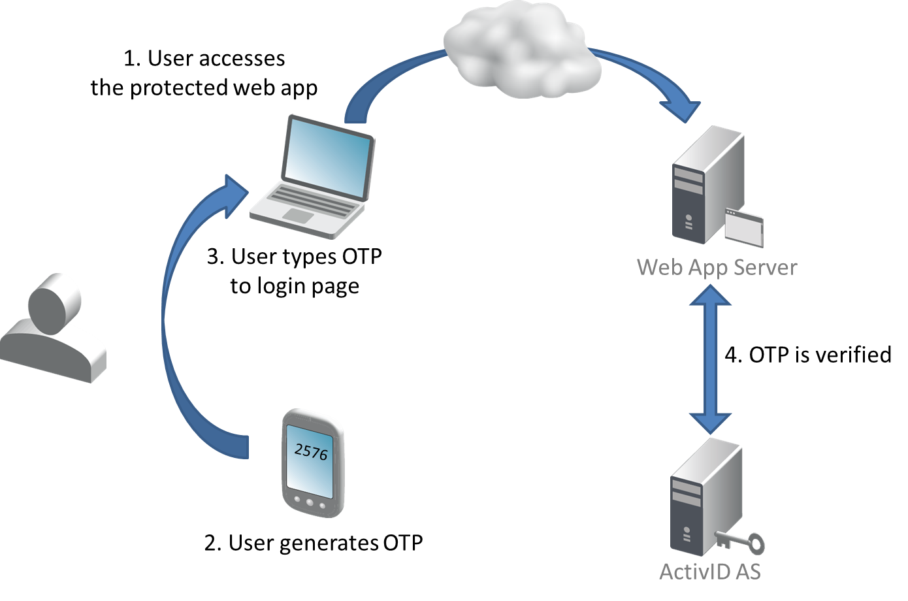
OTP WORKING

Slide 8

Flask is a micro web framework written in Python. It is classified as a microframework because it does not require particular tools or libraries. It has no database abstraction layer, form validation, or any other components where pre-existing third-party libraries provide common functions.

Slide 9
What is the purpose of OTP verification?
Reduce Friction
Verification of user data
Fraud prevention
Improve security

Slide 10
Why is the SMS the most effective method of OTP verification
SMS is simple authentication method.
The majority of folks own a smartphone.
SMS is both inexpensive and simple to use.
It is one of the most secured way.
SMS texts are read more frequently than emails and app notifications.

Slide 11
THANK YOU
FOR WATCHING

